Slide 1
Summer Research Project
Black Hole Population Modelling from Gravitational Wave Data
Jupiter Stevenson
01/07 - 26/09

Slide 2
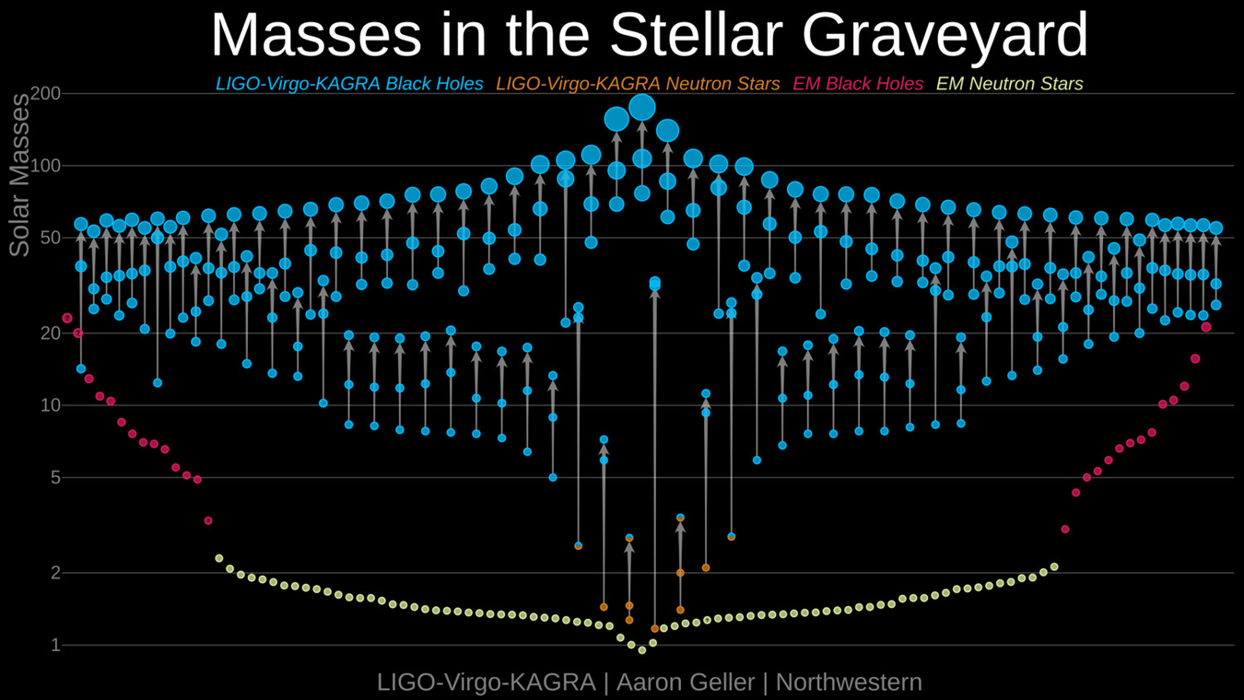
The Gravitational Wave Transient Catalogue
Consists of publicly released data from LVK collaboration
There are currently 182 events on the GWOSC events list, of which 93 are confident
GWTC (gwosc.org)
LIGO/Virgo Masses in the Stellar Graveyard

Slide 3
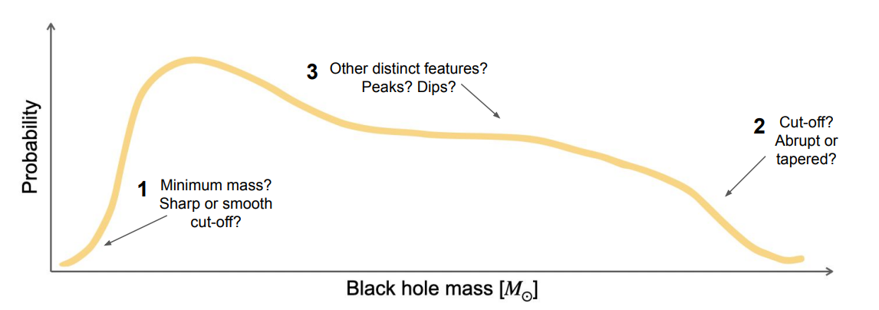
Mass Distribution Function
Analysis of the MDF furthers understanding of the evolution of massive stars
Is there a mass gap between the highest mass NSs and the lowest mass BHs, and why?
Where is the upper limit for BH formation?
What features of stellar evolution lead to peaks and dips?
How do second or third generation black holes factor into this distribution, and how can we identify them?
LIGO Webinar: GWTC-2 Populations

Slide 4
Bayesian Theory
P(D|M)P(M)
P(D)
Likelihood x Prior
Evidence
P(M|D)=
Posterior=
Posterior- P(M|D)
Prior- P(M)
Likelihood- P(D|M)
Evidence- P(D)
P(D|M )
P(D|M )
Evidence of Model A
Evidence of Model B
BF =
A
Bayes Factor =
AB
B
Why bother with Bayensian Theory?
The Bayes factor allows for easy model comparison, however it does not indicate if any given model is the best possible model

Slide 5
Parameter Estimation for a Single Event
Parameters | Desc | Intrinsic or Extrinsic? | Priors
M (solar mass) | Chirp Mass | Intrinsic | U(5,100)
q | Mass Ratio | Intrinsic | U(0.125, 0.99)
Xi | Spin | Intrinsic | U(0, 0.99)
ai | Spin Precession | Intrinsic | U(0, 0.99)
cos(θi) | cosine of tilt | Intrinsic | U(-1, 1)
t (seconds) | geocentric time | Extrinsic | U(t-0.1, t+0.1)
φ12 | Spin Orientation | Extrinsic | U(0, 2π)
φjl | Momentum Alignment | Extrinsic | U(0, 2π)
ψ | Polarisation Factor | Extrinsic | U(0, π)
ra (radians) | right ascension | Extrinsic | U(0, 2π)
dec (radians) | declination | Extrinsic | Cosine
d (Mpc) | Luminosity Distance | Extrinsic | U(1e2, 5e3)
θjn | Inclination | Extrinsic | Sine
phase | phase | Extrinsic | U(0, 2π)

Slide 6
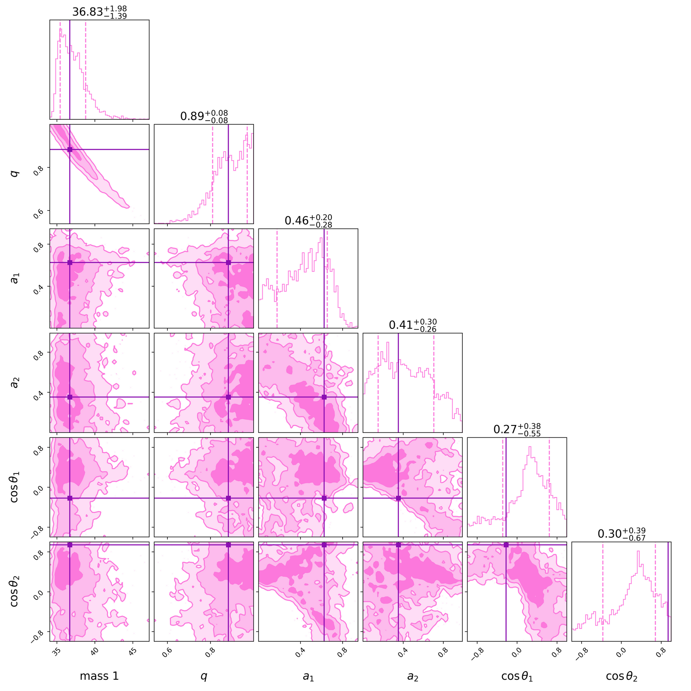
Parameter Estimation for a Single Event
Selected the IMRPhenomXPHM waveform approximant
Fixed any extrinsic values for individual events
Fixed intrinsic values relating to spin

Slide 7
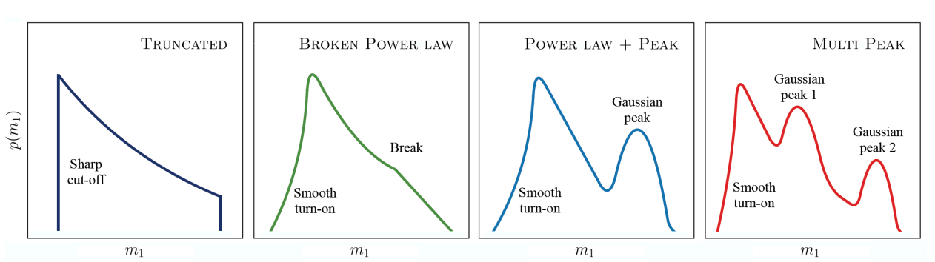
Parameter Estimation for a Population of Events
Different mass functions are definied by different parameters- I selected a Power Law + Peak model which has 7 parameters to estimate for the primary mass distribution
Parameters | Desc | Priors
α | spectral index for the power law component | U(-2, 4)
mmin | minimum mass for the power law component | U(10, 20)
mmax | maximum mass for the power law component | U(70, 80)
λ | fraction of systems in the gaussian component | U(0, 1)
µm | mean of the gaussian component | U(10, 50)
σm | width of the gaussian component | U(1, 5)
δm | range of mass tapering at the minimum | U(0, 10)
This model is justified as the peak arises as large mass (100-130 Solar masses) stars undergo mass loss as they go supernova (pulsational pair instability supernovae), causing a build-up of similar, lower mass black holes than what would be expected if the stars didn’t undergo mass loss
Abbott et al 2021 ApJL 913 L7
Abbott et al 2019 ApJL 882 L24

Slide 8
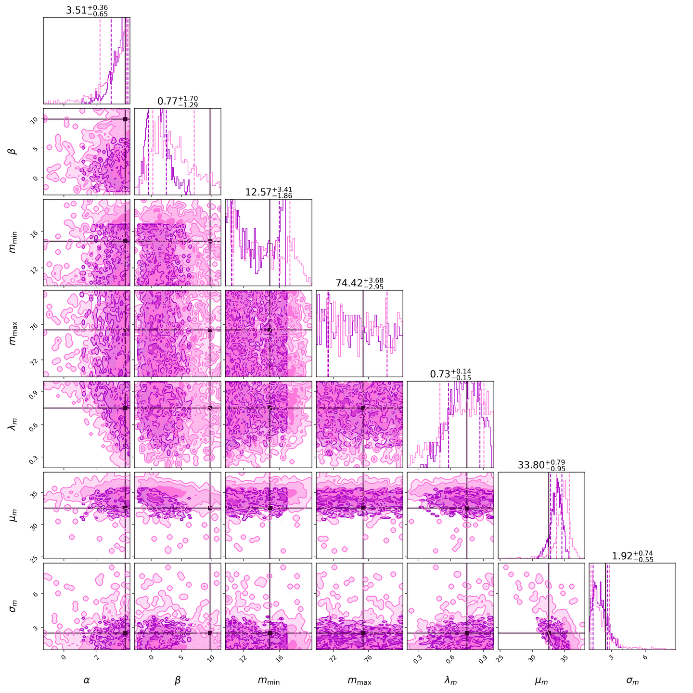
Parameter Estimation for a Population of Events

Slide 9
My Simulations
Parameter | Set Value
α | 3.71
mmin | 14.927
mmax | 75.3890
λ | 0.75
µm | 32.56
σm | 2.49
δm | 2
Set a MDF, thereby defining a “Universe” for the run with fixed parameters
Draw mass 1, q, a1, a2, cos(θ1), cos(θ2) and redshift for an event from the prior distribution
Inject the waveform signal for the event into the noisy interferometers
Check if detector SNR > 12 and network SNR > 8 (i.e. if the event can be resolved from noise)
If so, continue to through to sampling
If not, reject the event and return to drawing events
Sample for the most likely parameters for the individual event
Repeat until a sufficient number of events have been sampled, then collate all the sampler outputs into a single file
Set the output file as the posteriors for MDF parameter estimation and calculate the likelihood
Samples parameters for the MDF to identify the most likely
Compare to the initial MDF for the Universe

Slide 10
My Simulations
Applying the SNR threshold has have implications for the MDF:
Lower mass events are less likely to make it past the cut
Same for more distant events
There is therefore an inherent bias towards louder events, which are either closer, higher mass or both (i.e. Malmquist bias)
This is to simulate which events would actually be flagged as significant by GW pipelines, and so which would continue to further analysis
Ideal conditions are assumed within the simulations- the fixed extrinsic parameters are fixed to maximise their SNR (i.e. the gravitational waves are perfectly aligned with the IFO). This isn’t very realistic, but makes drawing conclusions easier

Slide 11
O
Some Meta-Data
Number of files generated
17822 Singular Events Generated
642 Events then sent through parameter estimation
146 Events in the final “proper” data set
128 Total Unique Events fed into the population parameter estimation
99.3% of initial events are discarded
Volume of data generated
15.2GB data generated in total from the first event log to the final plot
Of this, 5.2 MB corresponds to data used in the generation of the final results
This is an efficiency of 34.2% - pretty good!
Disregarding files from failed runs, the maximum efficiency for data used/data created is 99.94%- even better!

Slide 12
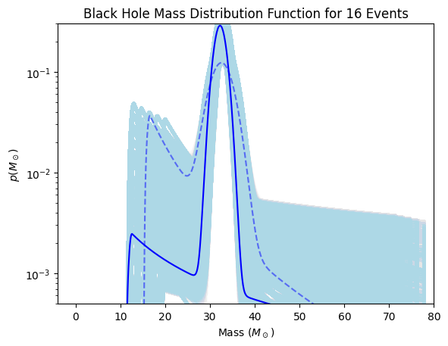
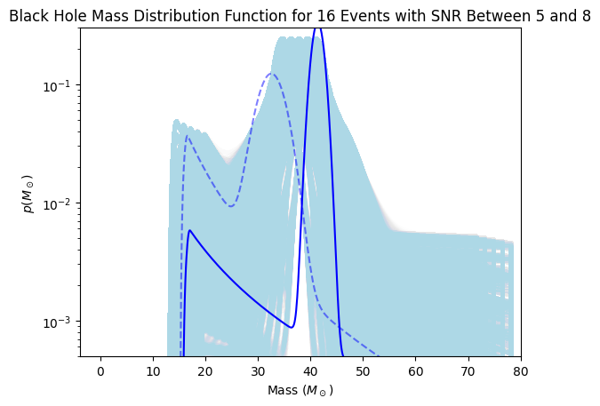
Results
SNR >8

Slide 13
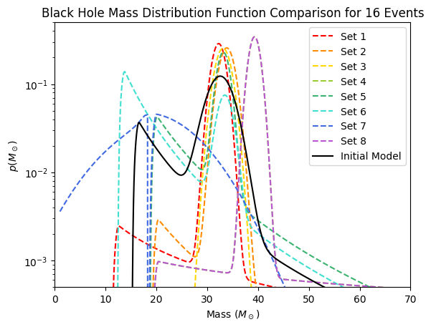
Results

Slide 14
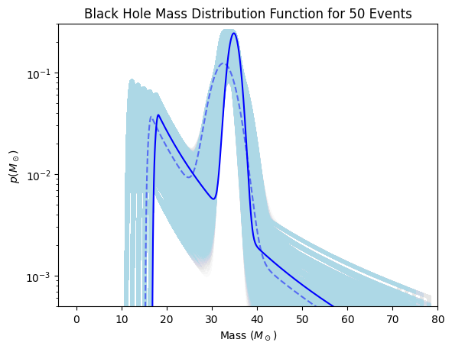
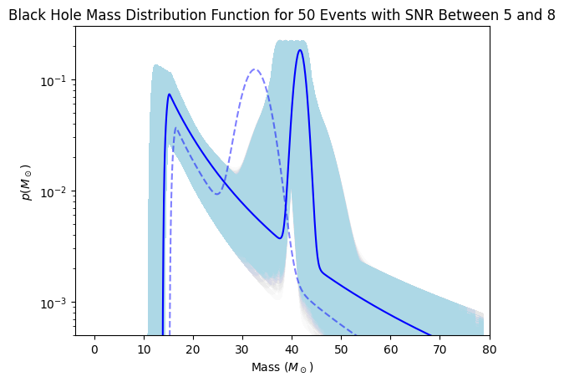
Results
SNR >8

Slide 15
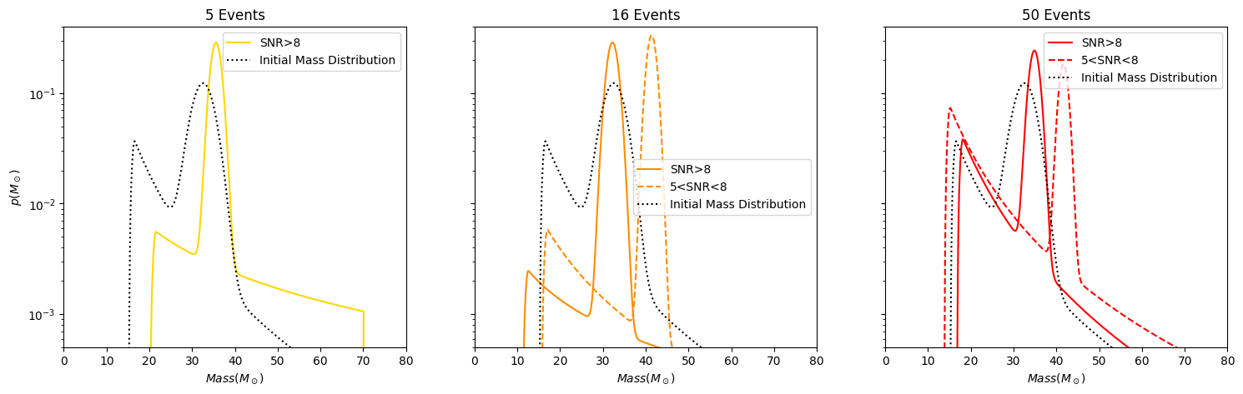
Results

Slide 16
Challenges Throughout
Computational Costs
Data Quantity vs Data Quality
Scientific Rigor
Time Constraints
Understanding the Theory vs Completing Research
Weird Bugs and Glitches

Slide 17
Further Research
Model Comparison
Comparing Different MDFs
Comparing how different waveform approximations affect the MDF
Running parameter estimation on real GWTC data
Comparing with Simulated
Estimating parameters for larger data sets
Better Data output
Conclusions could be drawn about the accuracy of MDFs derived from the real GWTC data
Further Exploration of Bias
How much does the Malmquist bias caused by the SNR cut (applied due to the IFO sensitivity) affect the MDF?
Can this be accurately adjusted for?
Introducing Spin

Slide 18
Thank you
Any Questions?

